Slide 1
Unit 2 – Network Communication Concepts

Slide 2
Contents
Parallel & Serial Communication
Synchronous & Asynchronous Communication
Modes of Communication: Simplex, Half-Duplex, Full-Duplex
Multiplexing, De-Multiplexing: FDM, TDM
Communication Media: Guided Media, Unguided Media
Switching Techniques: Circuit Switching, Message Switching, Packet Switching

Slide 3
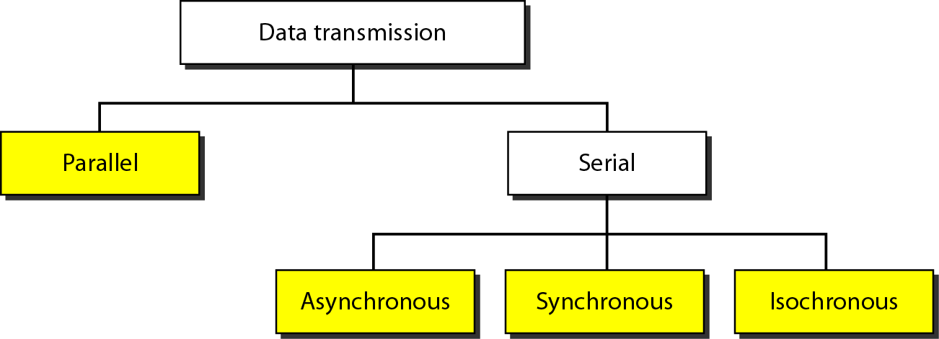
Parallel & Serial Communication

Slide 4
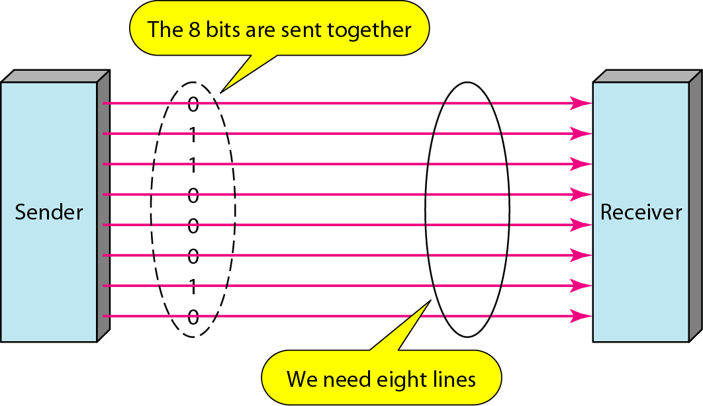
Parallel & Serial Communication

Slide 5
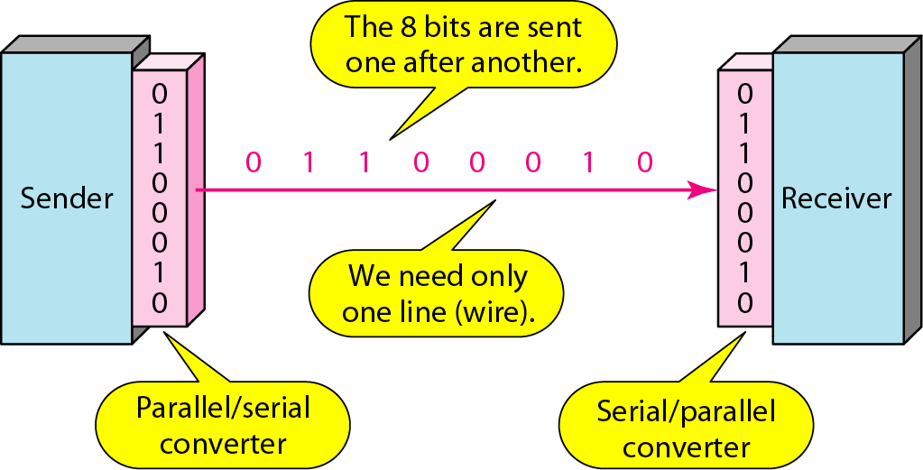
Parallel & Serial Communication

Slide 6
Contents
Parallel & Serial Communication
Synchronous & Asynchronous Communication
Modes of Communication: Simple, Half-Duplex, Full-Duplex
Multiplexing, De-Multiplexing: FDA, TDM
Communication Media: Guided Media, Unguided Media
Switching Techniques: Circuit Switching, Message Switching, Packet Switching

Slide 7
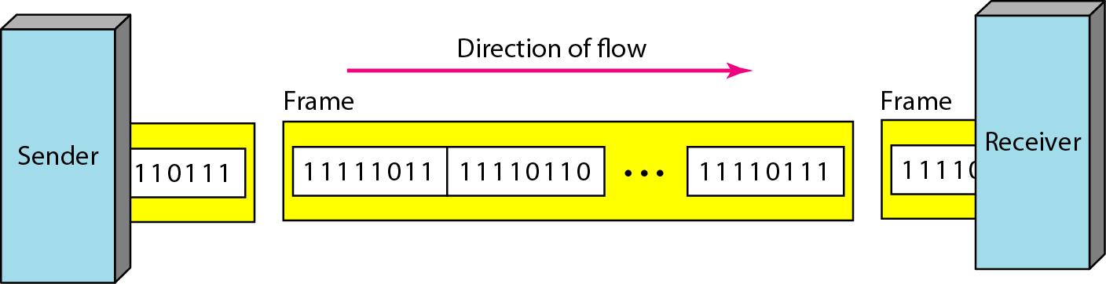
Synchronous & Asynchronous Communication
In synchronous transmission, we send bits one after another without start or stop bits or gaps. It is the responsibility of the receiver to group the bits.

Slide 8
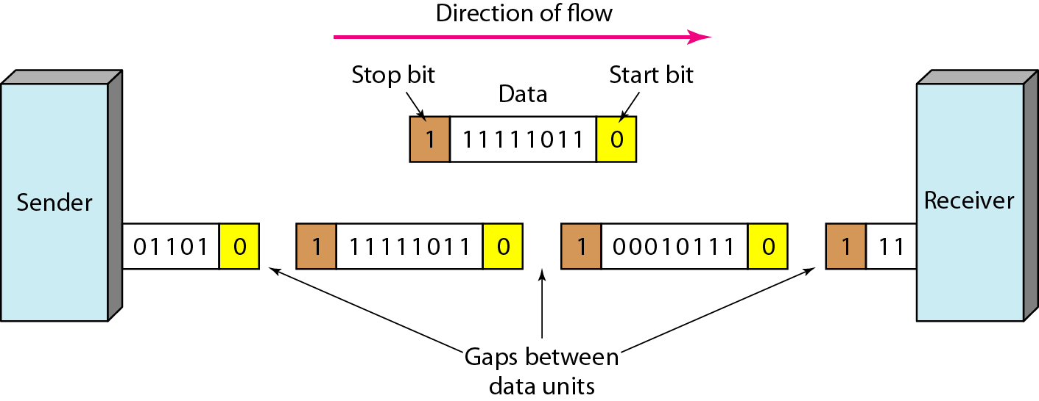
Synchronous & Asynchronous Communication
In asynchronous transmission, we send 1 start bit (0) at the beginning and 1 or more stop bits (1s) at the end of each byte. There may be a gap between each byte.

Slide 9
Synchronous & Asynchronous Communication
Asynchronous here means “asynchronous at the byte level, but the bits are still synchronized; their duration is the same.

Slide 10
Contents
Parallel & Serial Communication
Synchronous & Asynchronous Communication
Modes of Communication: Simplex, Half-Duplex, Full-Duplex
Multiplexing, De-Multiplexing: FDM, TDM
Communication Media: Guided Media, Unguided Media
Switching Techniques: Circuit Switching, Message Switching, Packet Switching

Slide 11
Modes of Communication: Simplex, Half-Duplex, Full-Duplex
Communication between two devices can be:
Simplex
Half-Duplex
Full-Duplex

Slide 12
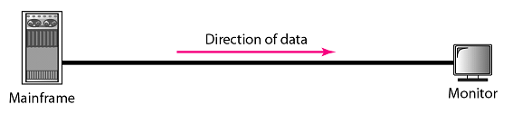
Modes of Communication: Simplex
One way street
The communication is unidirectional
Only one device on a link can transmit; the other can only receive
Use the entire capacity of the channel to send data
Example: Keyboards, Monitors

Slide 13

Modes of Communication: Half-duplex
One-lane with two-directional traffic.
Each station can both transmit and receive, but not at the same time
When one device is sending, the other can only receive, and vice versa
The entire capacity of a channel is taken over by the transmitting device
Example: Walkie-talkies
Data
Data

Slide 14

Modes of Communication: full-duplex
Two way street
Both stations can transmit and receive at same time
Signals going in either direction sharing the capacity of the link
Sharing can occur in two ways:
Link has two physically separate transmission paths
One for sending and the other for receiving
The capacity of the channel is divided between signals travelling in both directions
Example: Telephone network
Data
Data

Slide 15
Contents
Parallel & Serial Communication
Synchronous & Asynchronous Communication
Modes of Communication: Simplex, Half-Duplex, Full-Duplex
Multiplexing, De-Multiplexing: FDM, TDM
Communication Media: Guided Media, Unguided Media
Switching Techniques: Circuit Switching, Message Switching, Packet Switching

Slide 16
Multiplexing, De-Multiplexing: FDM, TDM
The communication takes place by transmission of data from one place to the other.
This requires transforming data from one type to another.
Typically to send data from place A to place B, the digital data is converted into signals which are then transferred through telephone lines, optical fiber cables or wireless mediums.
Normally, there is a single channel that carries multiple signals from place A to place B.
Like, single wire from electricity pole carrying electricity for whole apartment, instead of having one wire for each apartment from the pole.
This is called multiplexing.

Slide 17
Multiplexing, De-Multiplexing: FDM, TDM
On receiving end, the signals are separated from channel.
This process is called de-multiplexing.

Slide 18
Multiplexing, De-Multiplexing: FDM, TDM
Bandwidth utilization is the wise use of available bandwidth to achieve specific goals.
Efficiency can be achieved by multiplexing; i.e., sharing of the bandwidth between multiple users.
Whenever the bandwidth of a medium linking two devices is greater than the bandwidth needs of the devices, the link can be shared.
Multiplexing is the set of techniques that allows the (simultaneous) transmission of multiple signals across a single data link.
As data and telecommunications use increases, so does traffic.

Slide 19
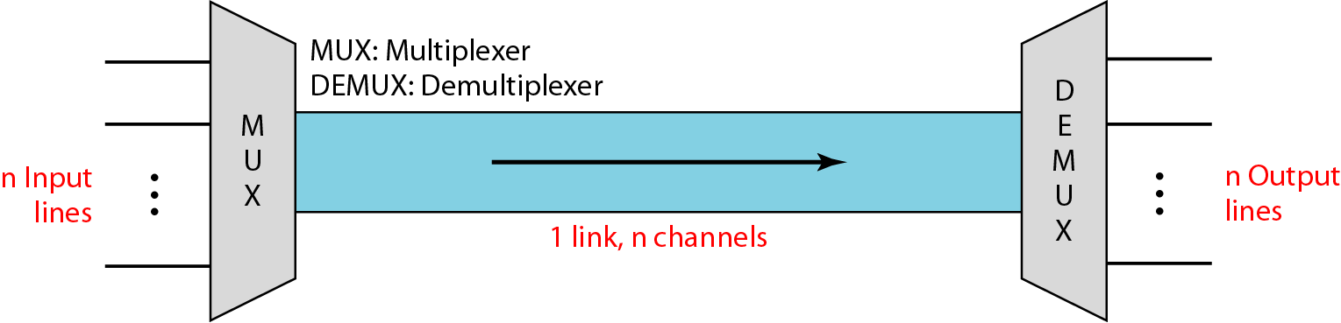
Multiplexing, De-Multiplexing: FDM, TDM

Slide 20
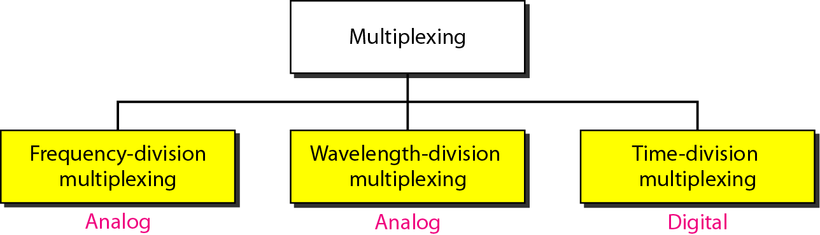
Multiplexing, De-Multiplexing: FDM, TDM
Categories of multiplexing:

Slide 21
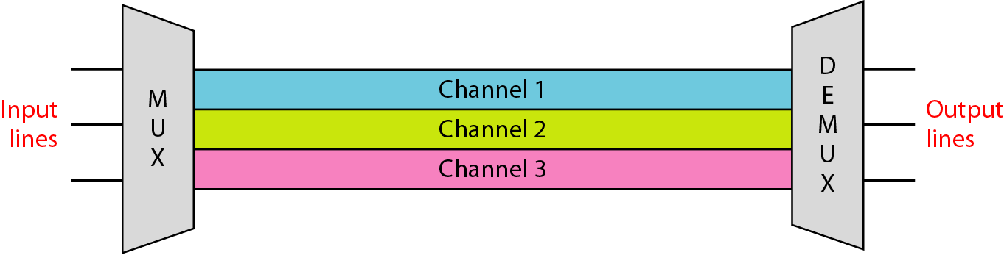
Multiplexing, De-Multiplexing: FDM, TDM
Frequency-division multiplexing (FDM)
FDM is an analog multiplexing technique that combines analog signals.
It uses the concept of modulation discussed in Ch 5.

Slide 22
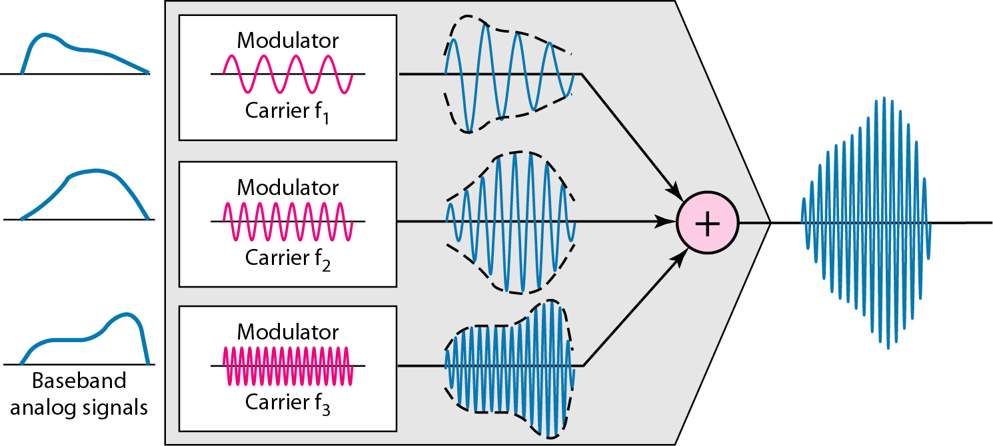
Multiplexing, De-Multiplexing: FDM, TDM
FDM Process

Slide 23
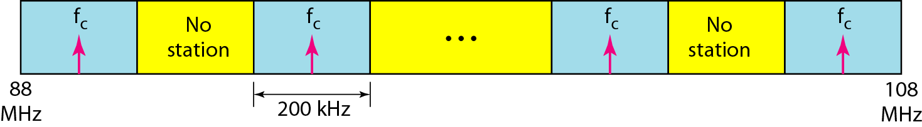
Multiplexing, De-Multiplexing: FDM, TDM
FDM

Slide 24
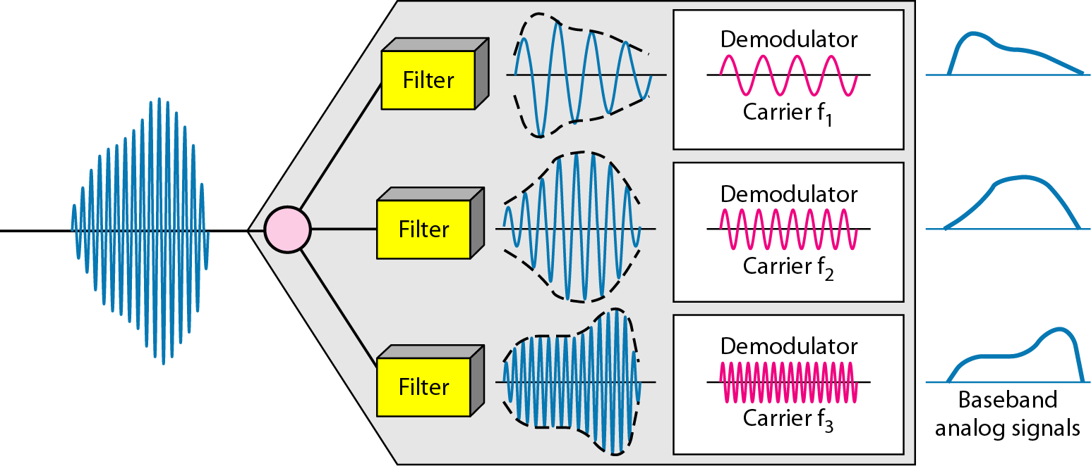
Multiplexing, De-Multiplexing: FDM, TDM
FDM De-Multiplexing example

Slide 25
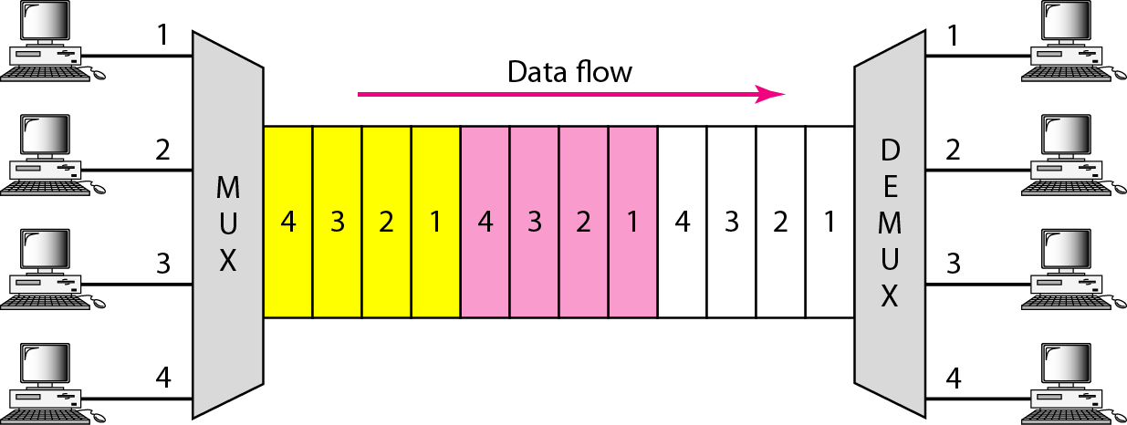
Multiplexing, De-Multiplexing: FDM, TDM
Time Division Multiplexing (TDM)

Slide 26
Multiplexing, De-Multiplexing: FDM, TDM
TDM is a digital multiplexing technique for combining several low-rate digital channels into one high-rate one.

Slide 27
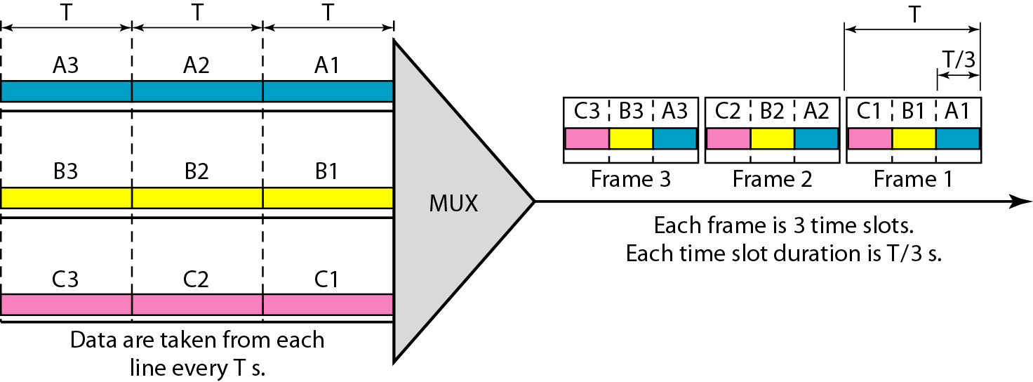
Multiplexing, De-Multiplexing: FDM, TDM
Synchronous time-division multiplexing
In synchronous TDM, the data rate of the link is n times faster, and the unit duration is n times shorter.

Slide 28
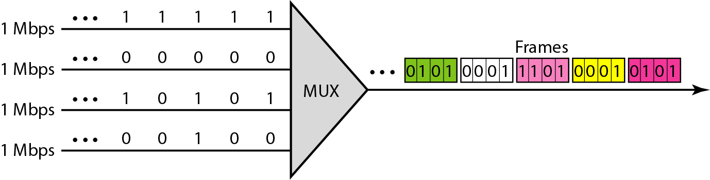
Multiplexing, De-Multiplexing: FDM, TDM

Slide 29
Contents
Parallel & Serial Communication
Synchronous & Asynchronous Communication
Modes of Communication: Simplex, Half-Duplex, Full-Duplex
Multiplexing, De-Multiplexing: FDM, TDM
Communication Media: Guided Media, Unguided Media
Switching Techniques: Circuit Switching, Message Switching, Packet Switching

Slide 30
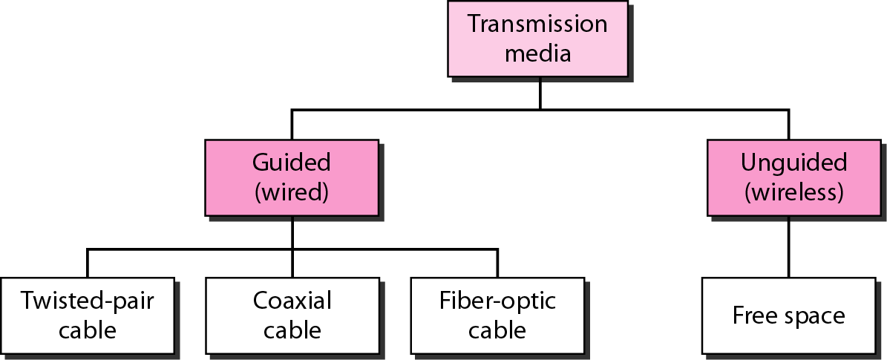
Communication Media: Guided Media, Unguided Media

Slide 31
Communication Media: Guided Media, Unguided Media
Guided media, which are those that provide a conduit from one device to another, include twisted-pair cable, coaxial cable, and fiber-optic cable.

Slide 32
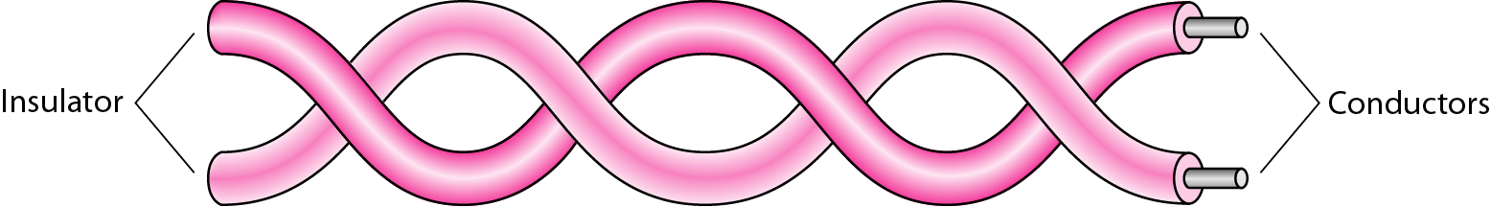
Communication Media: Guided Media, Unguided Media
Twisted Pair Cable

Slide 33
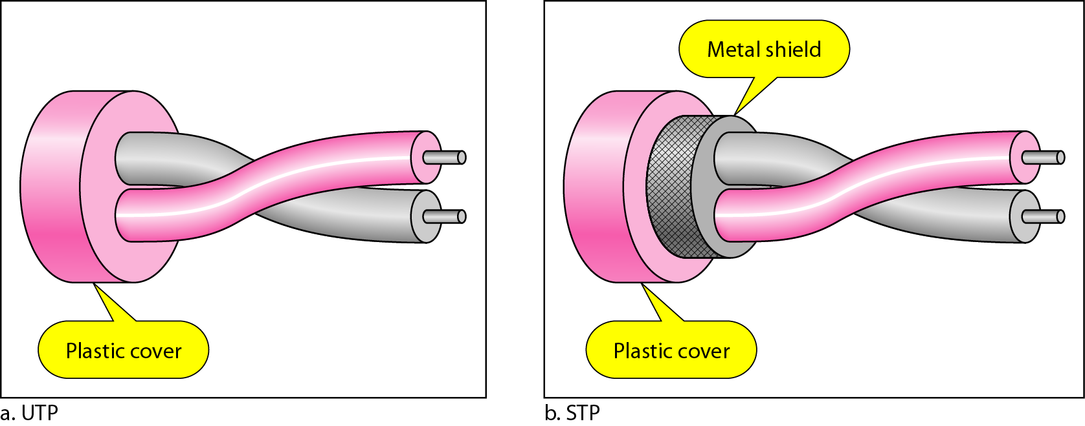
Communication Media: Guided Media, Unguided Media
UTP and STP cables

Slide 34
Communication Media: Guided Media, Unguided Media
Categories of unshielded twisted-pair cables

Slide 35
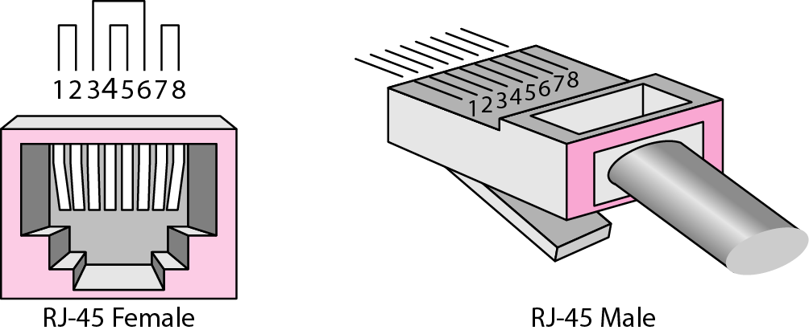
Communication Media: Guided Media, Unguided Media
UTP connector

Slide 36
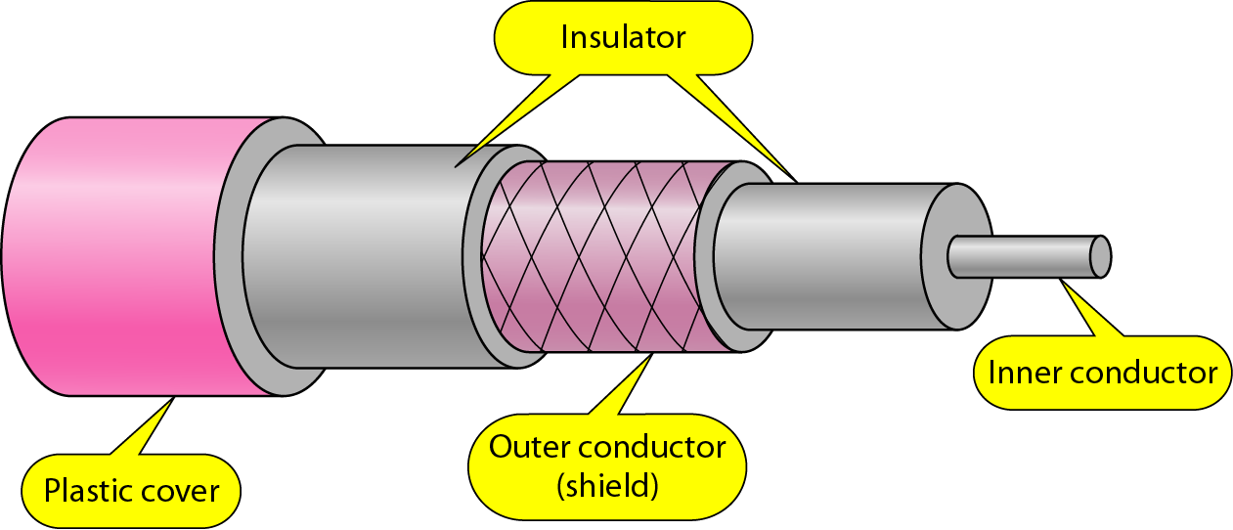
Communication Media: Guided Media, Unguided Media
Coaxial cable

Slide 37
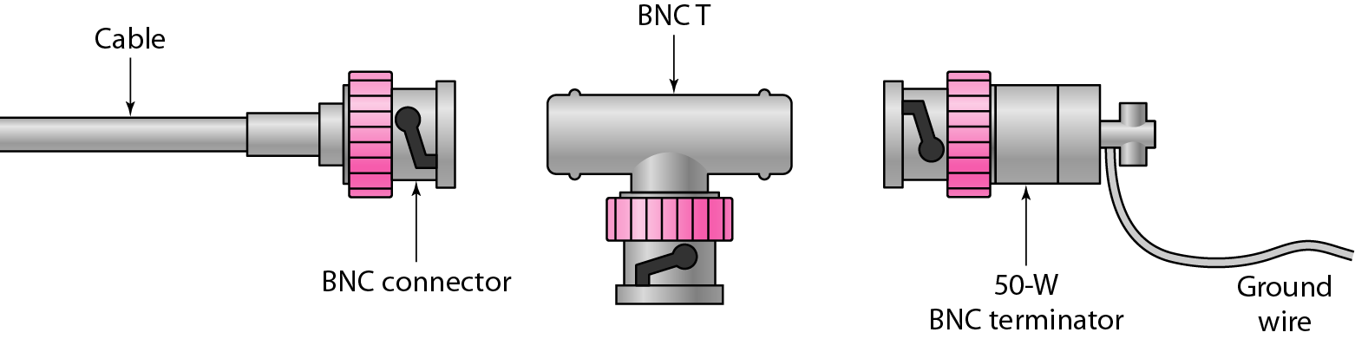
Communication Media: Guided Media, Unguided Media
BNC connectors

Slide 38
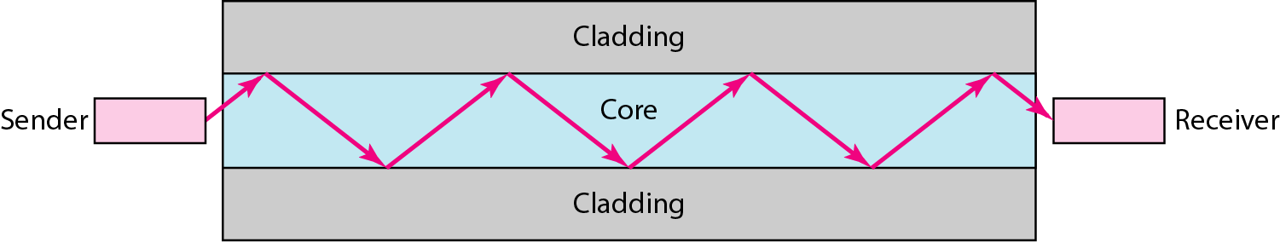
Communication Media: Guided Media, Unguided Media
Optical fiber

Slide 39
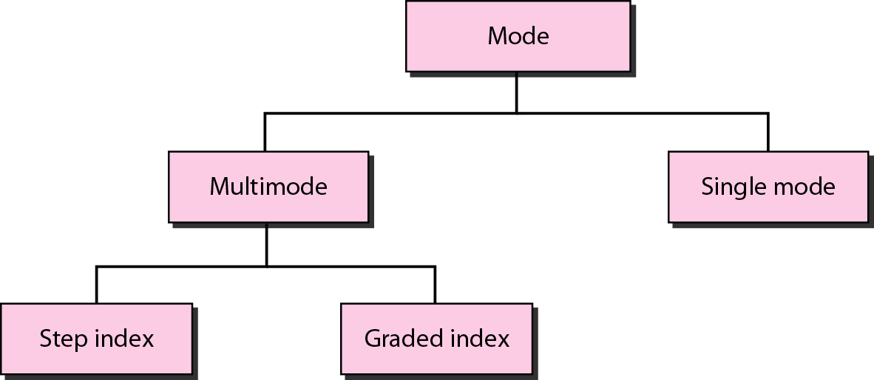
Communication Media: Guided Media, Unguided Media
Optical Fiber
Propagation modes

Slide 40
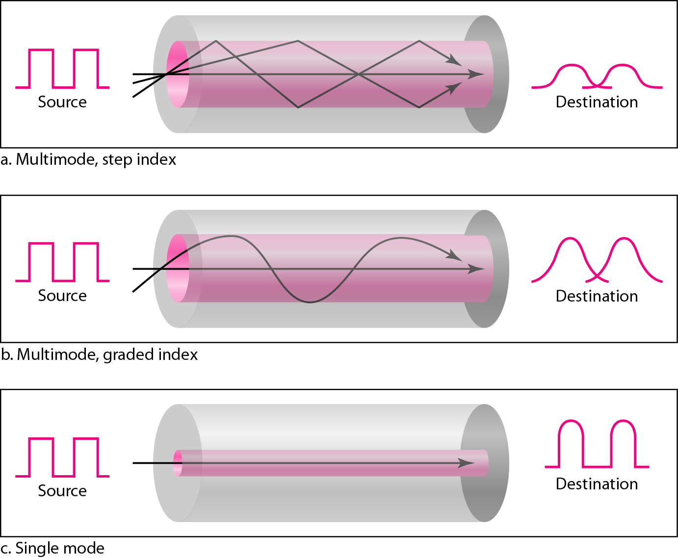
Communication Media: Guided Media, Unguided Media
Optical Fiber – Modes

Slide 41
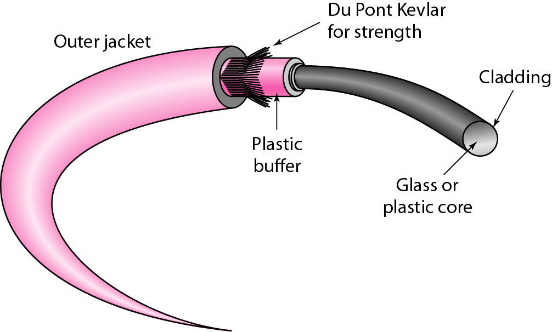
Communication Media: Guided Media, Unguided Media
Fiber construction

Slide 42
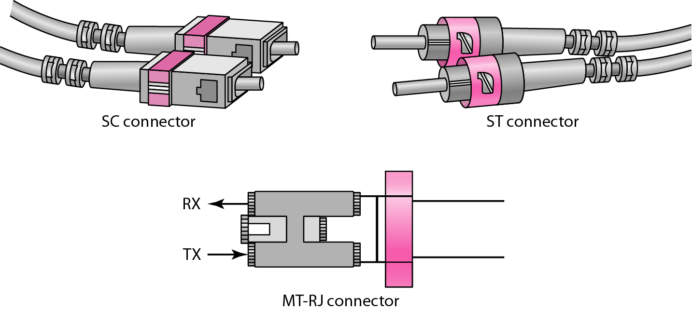
Communication Media: Guided Media, Unguided Media
Fiber-optic cable connectors

Slide 43
Communication Media: Guided Media, Unguided Media
Unguided media transport electromagnetic waves without using a physical conductor. This type of communication is often referred to as wireless communication

Slide 44
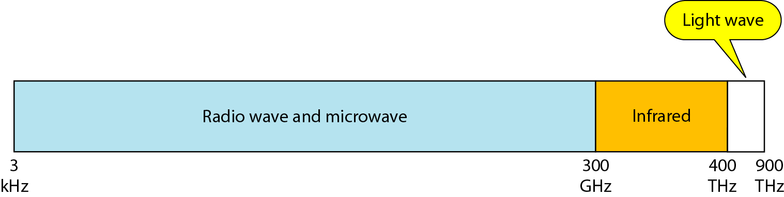
Communication Media: Guided Media, Unguided Media
Electromagnetic spectrum for wireless communication

Slide 45
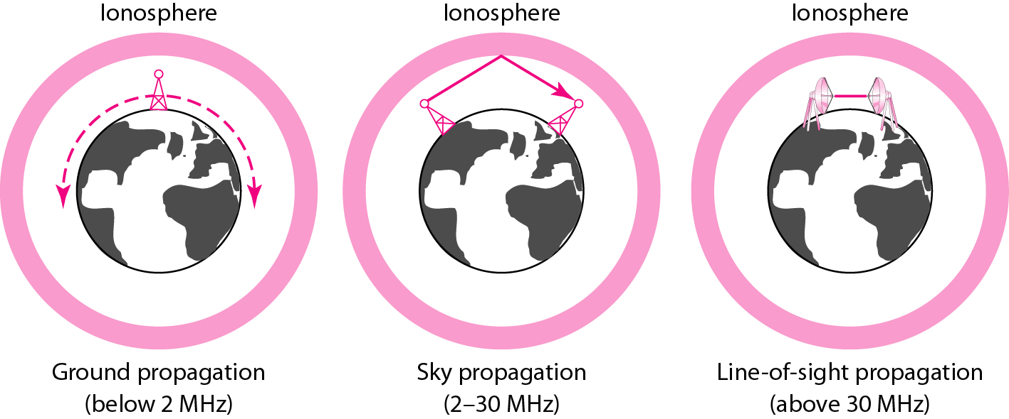
Communication Media: Guided Media, Unguided Media
Propagation methods

Slide 46
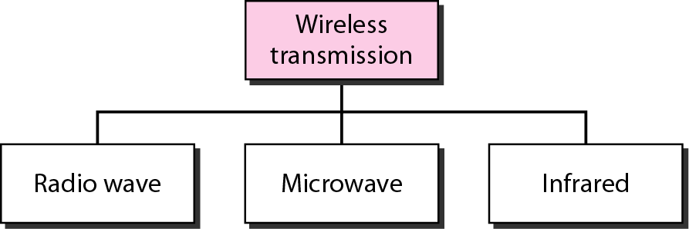
Communication Media: Guided Media, Unguided Media
Wireless transmission waves

Slide 47
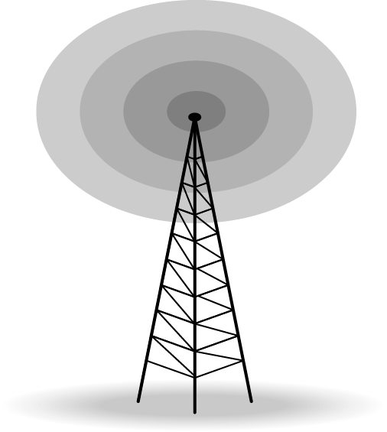
Communication Media: Guided Media, Unguided Media
Radio waves are used for multicast communications, such as radio and television, and paging systems. They can penetrate through walls.
Highly regulated. Use omni directional antennas

Slide 48
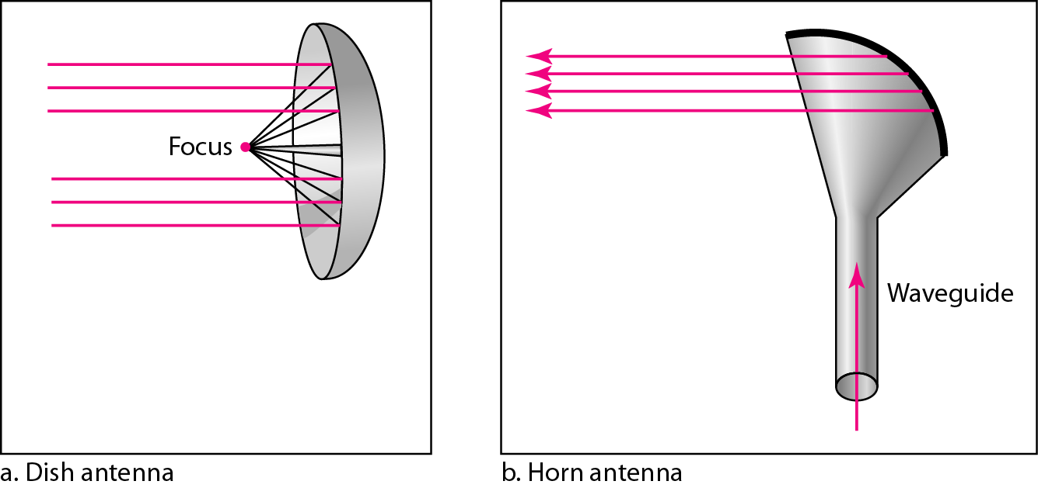
Communication Media: Guided Media, Unguided Media
Microwaves are used for unicast communication such as cellular telephones, satellite networks,and wireless LANs.
Higher frequency ranges cannot penetrate walls.
Use directional antennas - point to point line of sight communications.

Slide 49
Communication Media: Guided Media, Unguided Media
Infrared signals can be used for short-range communication in a closed area using line-of-sight propagation.

Slide 50
Communication Media: Guided Media, Unguided Media
Wireless communication channels
Are subject to a lot more errors than guided media channels.
Interference is one cause for errors, can be circumvented with high SNR.
The higher the SNR the less capacity is available for transmission due to the broadcast nature of the channel.
Channel also subject to fading and no coverage holes.

Slide 51
Contents
Parallel & Serial Communication
Synchronous & Asynchronous Communication
Modes of Communication: Simplex, Half-Duplex, Full-Duplex
Multiplexing, De-Multiplexing: FDM, TDM
Communication Media: Guided Media, Unguided Media
Switching Techniques: Circuit Switching, Message Switching, Packet Switching

Slide 52
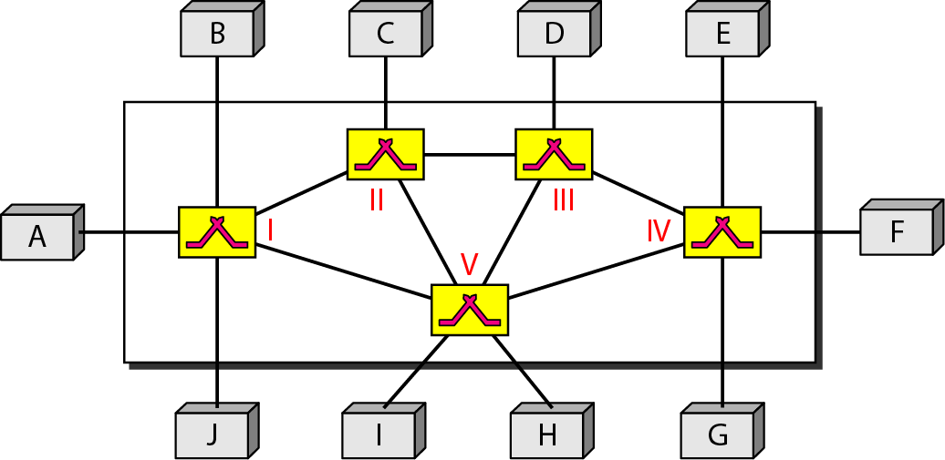
Switching Techniques: Circuit Switching, Message Switching, Packet Switching

Slide 53
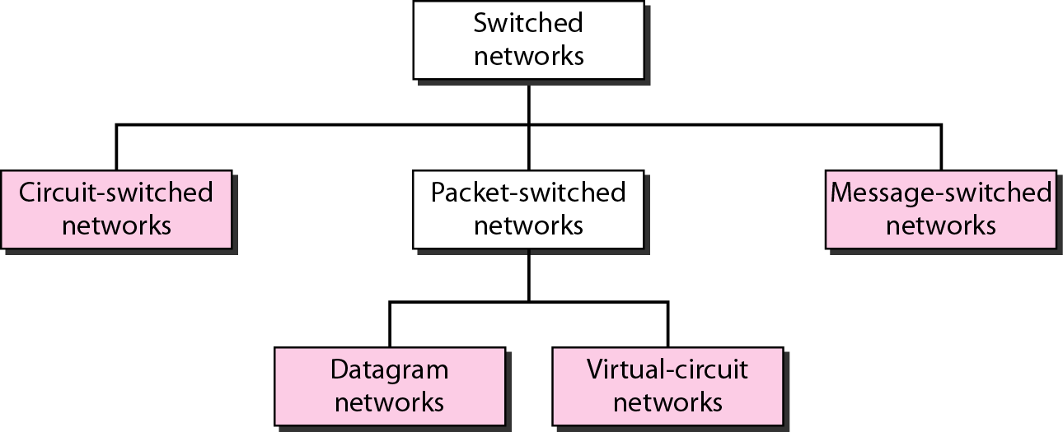
Switching Techniques: Circuit Switching, Message Switching, Packet Switching

Slide 54
Switching Techniques: Circuit Switching, Message Switching, Packet Switching
Circuit Switching
A circuit-switched network consists of a set of switches connected by physical links.
A connection between two stations is a dedicated path made of one or more links.
However, each connection uses only one dedicated channel on each link.
Each link is normally divided into n channels by using FDM or TDM.

Slide 55
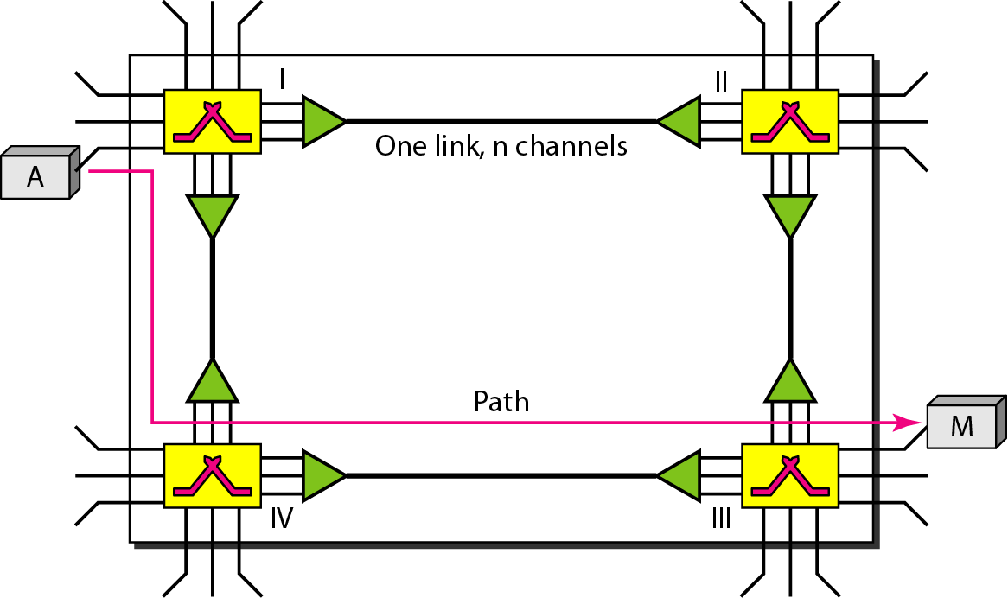
Switching Techniques: Circuit Switching, Message Switching, Packet Switching

Slide 56
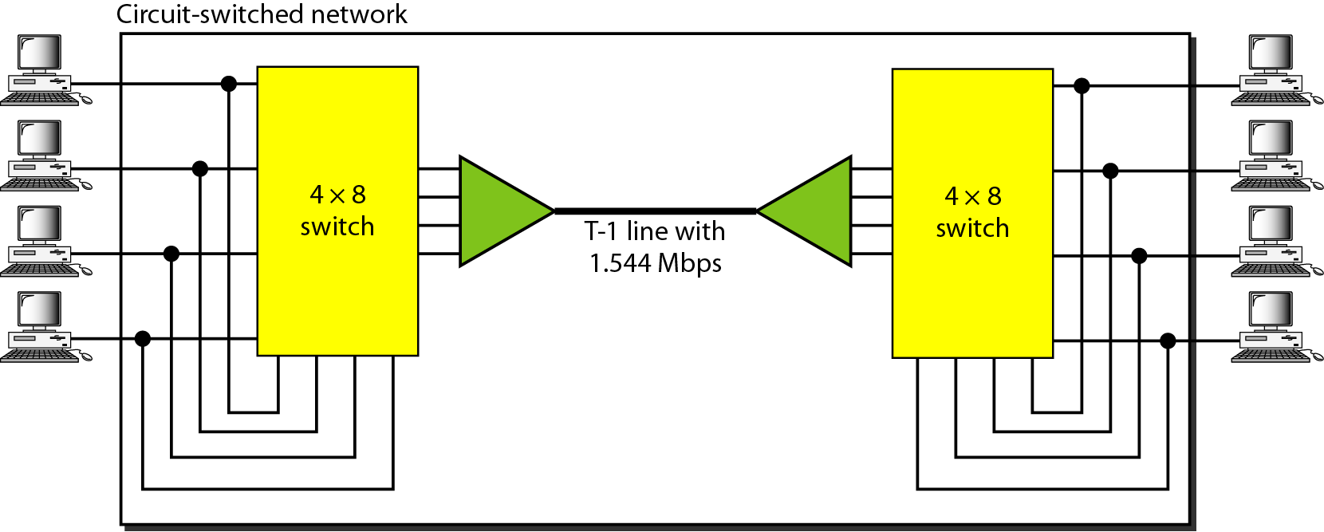
Switching Techniques: Circuit Switching, Message Switching, Packet Switching
In circuit switching, the resources need to be reserved during the setup phase; the resources remain dedicated for the entire duration of data transfer until the teardown phase.

Slide 57
Switching Techniques: Circuit Switching, Message Switching, Packet Switching
Switching at the physical layer in the traditional telephone network uses the circuit-switching approach.

Slide 58
Switching Techniques: Circuit Switching, Message Switching, Packet Switching
The complete physical connection is established before any data can be exchanged.
Since circuits are switched it gets it’s name.
Earlier switching was done manually. There was an operator who would reside in switching office and plug a jumper connecting input & output sockets. Now switching is done automatically.

Slide 59
Switching Techniques: Circuit Switching, Message Switching, Packet Switching
Packet Switching
In data communications, we need to send messages from one end system to another.
If the message is going to pass through a packet-switched network, it needs to be divided into packets of fixed or variable size.
The size of the packet is determined by the network and the governing protocol.
The packets are handled in two ways
Datagram
Virtual Circuit

Slide 60
Switching Techniques: Circuit Switching, Message Switching, Packet Switching
No physical copper path is established in advance between the sender and the receiver as in circuit switching.
Instead, the sent data is first stored in the first switching office and then forwarded later, one hop at a time.
Each block is received entirely, inspected for errors, and then retransmitted. This procedure continues until message reaches its destination. Owing to its working principle, it is also known as store and forward.

Slide 61
Switching Techniques: Circuit Switching, Message Switching, Packet Switching
Datagram
Each packet treated independently
Packets can take any practical route
Packets may arrive out of order
Packets may get lost or delayed
Up to receiver to re-order packets and recover from missing packets
Virtual Circuit
Preplanned route established before any packets sent
Call request and call accept packets establish connection (handshake)
Each packet contains a virtual circuit identifier instead of destination address
No routing decisions required for each packet
Clear request to drop circuit
Not a dedicated

Slide 62
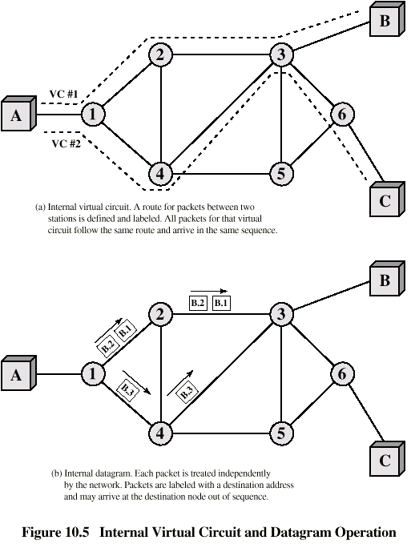
Switching Techniques: Circuit Switching, Message Switching, Packet Switching
Virtual Circuit vs. Datagram Switching

Slide 63
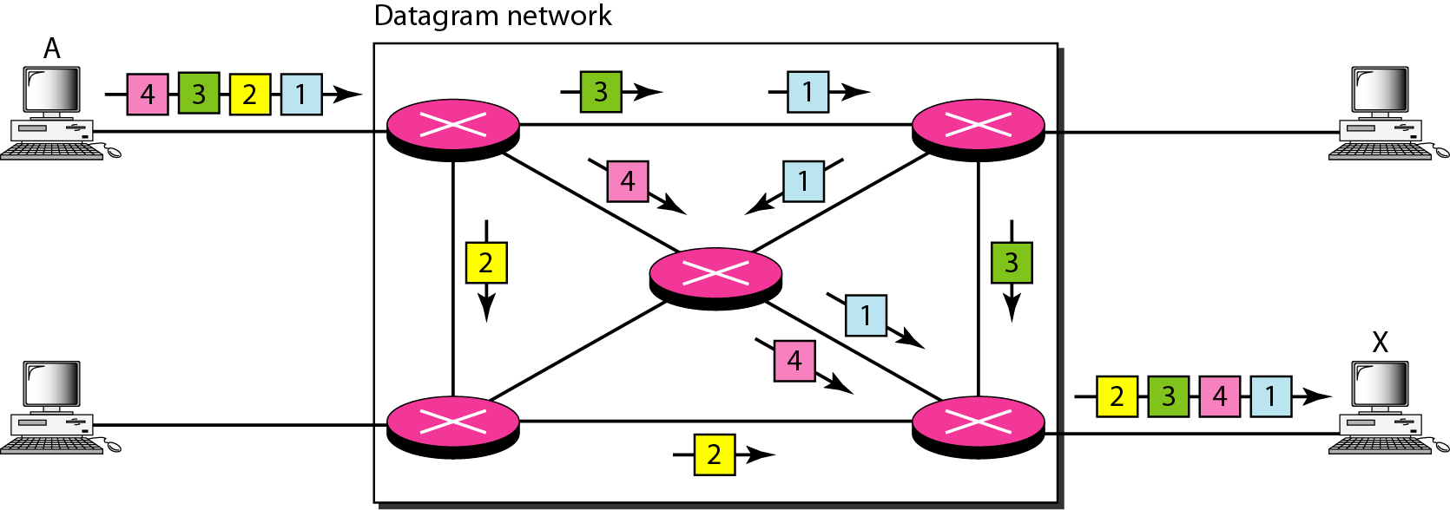
Switching Techniques: Circuit Switching, Message Switching, Packet Switching
A datagram network with four switches (routers)

Slide 64
Switching Techniques: Circuit Switching, Message Switching, Packet Switching
In virtual-circuit switching, all packets belonging to the same source and destination travel the same path; but the packets may arrive at the destination with different delays if resource allocation is on demand.

Slide 65
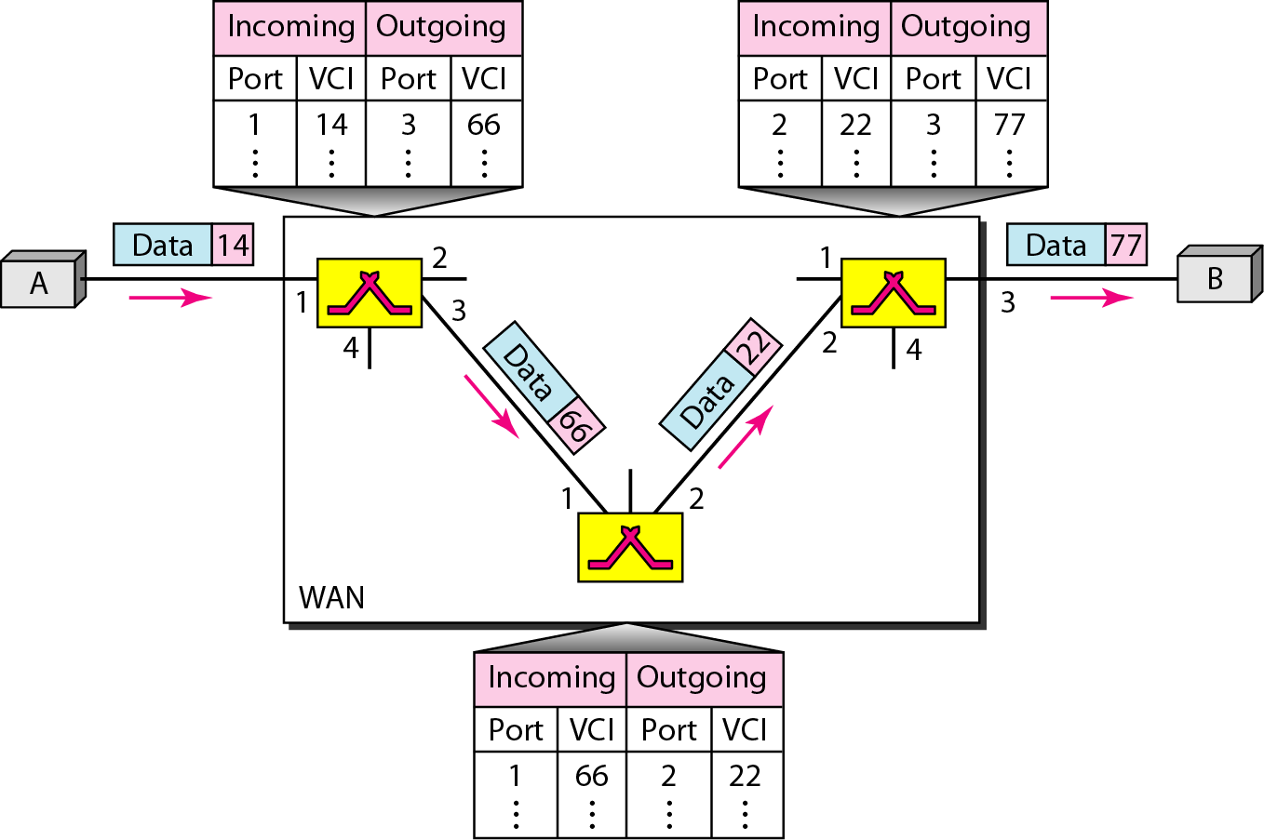
Switching Techniques: Circuit Switching, Message Switching, Packet Switching

